Slide 1
MISSION UPDATES
May 2026

Slide 2
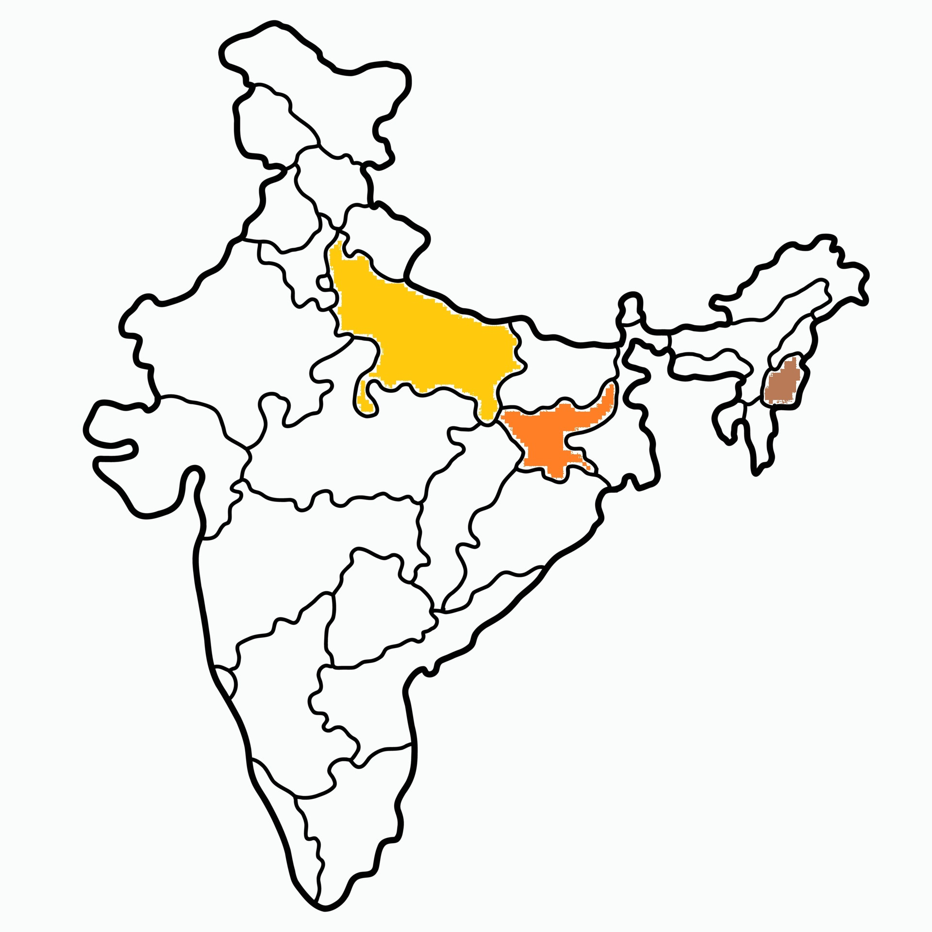

Slide 3
Mission Stations
10 mission stations supported in Jharkhand – Khunti Dist.
5 mission stations supported in U.P. – Balia(2) and Varanasi Dist. (3)
1 ICPF workstation supported in North-east India (Dimapur).

Slide 4
NORTH INDIA MISSION
UP
5 Stations - ₹3000 each
Balia and Varanasi
Jharkhand
10 Stations - ₹3000 each
Khunti District
ICPF
1 Station - ₹5000
Dimapur

Slide 5
Jharkhand

Slide 6
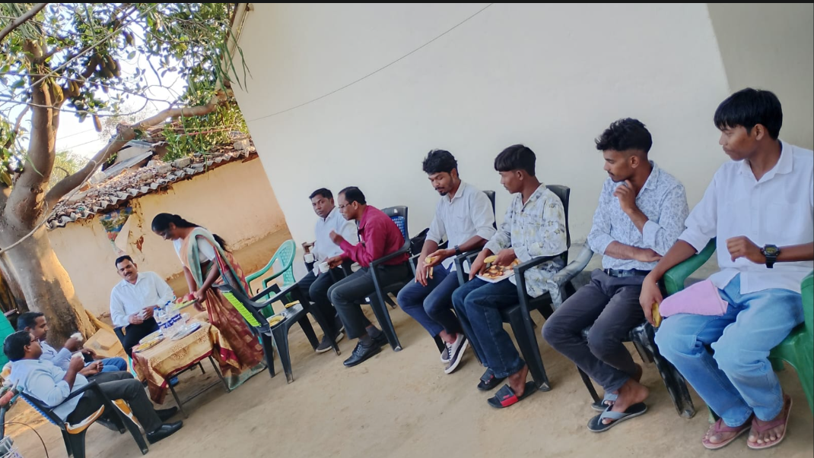
Village Visiting
Four young men are ready for Bible School, traveling to Bhopal to pursue B.Th

Slide 7
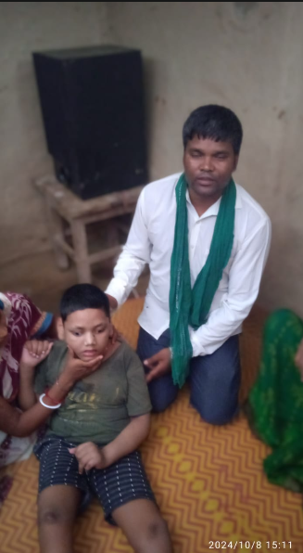
Praying for the Sick

Slide 8
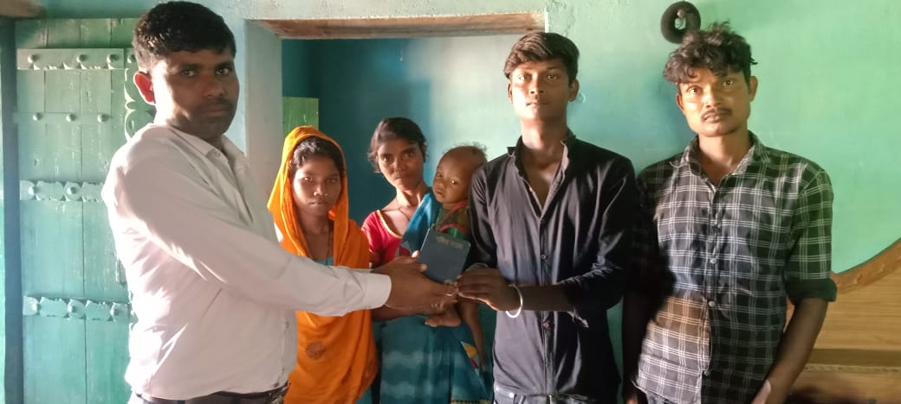
New Family added to Church

Slide 9
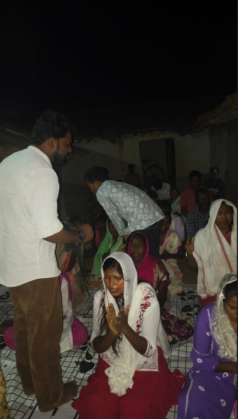
Night prayer in a Village

Slide 10
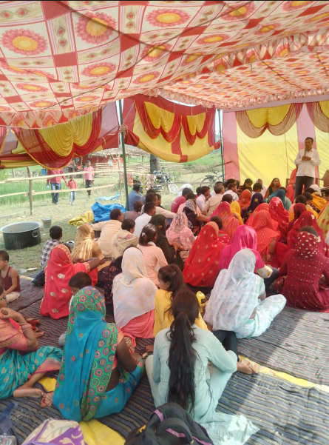
7 Days Fasting Prayer

Slide 11
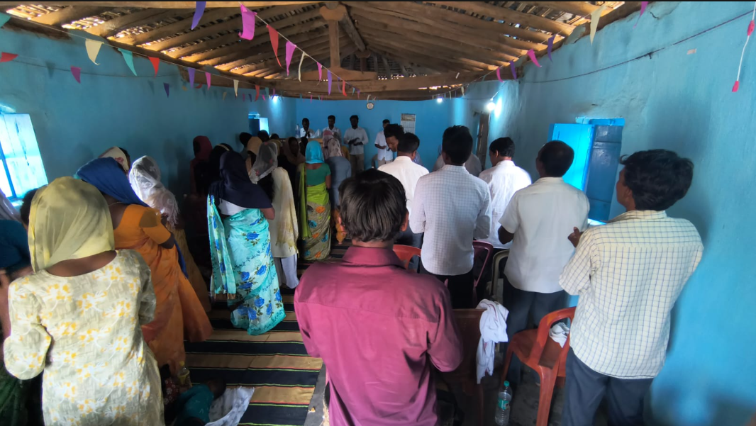
Village Church

Slide 12
Thank You

